Slide 1
Simultaneous equations – Elimination Method

Slide 2
Hook
Review previous lesson
Watch
http://education.abc.net.au/home#!/media/1605241/linear-simultaneous-equations-elimination

Slide 3
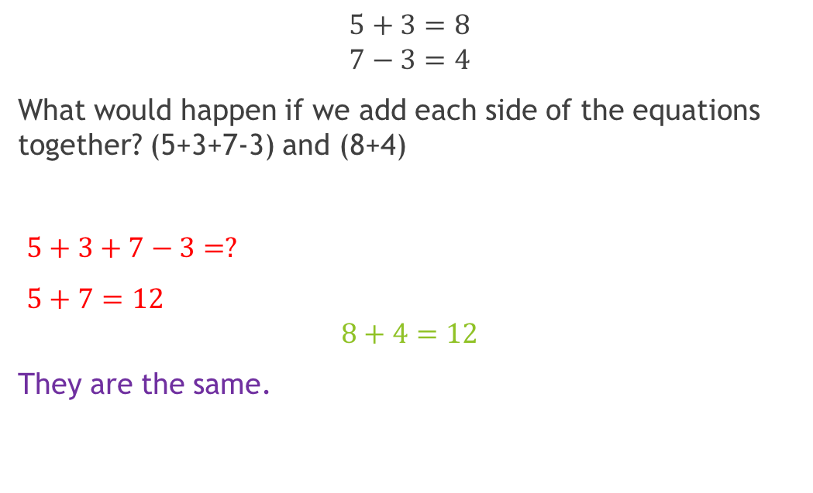
Do you agree?
$$5+3=8 \\ 7−3=4$$
What would happen if we add each side of the equations together? (5+3+7-3) and (8+4)
$5+3+7−3=?$
$5+7=12$ $$8+4=12$$
They are the same.
The 3s get eliminated
(3-3=0)
Notes:
hook

Slide 4
24
7
30
Date
Simultaneous equations
EQ –How can we solve simultaneous equations with the elimination method
Watch
http://education.abc.net.au/home#!/media/1605241/linear-simultaneous-equations-elimination
If two (or more) equations have the same variables and the same solutions then they are simultaneous equations.
'Solving' simultaneous equations means finding the values of 'x' and 'y' that make them true. The following steps will demonstrate how to solve simultaneous equations by the substitution method.
5
Notes:
Lesson objective (EQ)

Slide 5
Lesson objective
By the end of this lesson you will be able to;
- Solve Simultaneous equations using the elimination method.
Notes:
Lesson

Slide 6

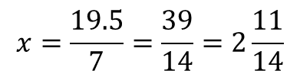
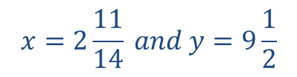
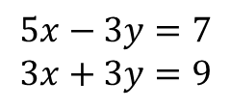



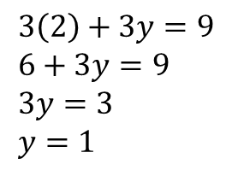


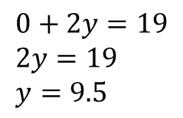

24
7
30
Date
Simultaneous equations
EQ –How can we solve simultaneous equations with the elimination method
The elimination method is where we eliminate one of the variables in order to solve.
$$7x−y=10 \\ −7x+3y=9$$
Add each side together to eliminate.
Solve for the variable
Solve for other variable
$$5x−3y=7 \\ 3x+3y=9$$
$$0+2y=19 \\ 2y=19 \\ y=9.5$$
$$8x+0=16$$
$$8x=16$$
$$x=2$$
$$7x−\left(9.5\right)=10$$
$$7x=19.5$$
$$3\left(2\right)+3y=9 \\ 6+3y=9 \\ 3y=3 \\ y=1$$
$$x=\frac{19.5}{7}=\frac{39}{14}=2\frac{11}{14}$$
$$x=2 and y=1$$
$$x=2\frac{11}{14} and y=9\frac{1}{2}$$
5

Slide 7
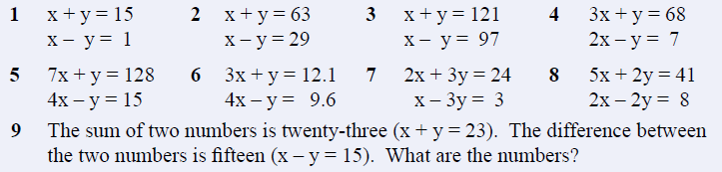
Use the elimination method to solve these please!
Notes:
Check for understanding/ independent practice

Slide 8
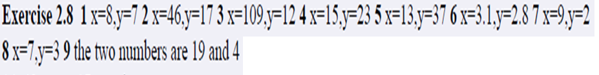
Answers

Slide 9
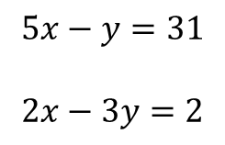



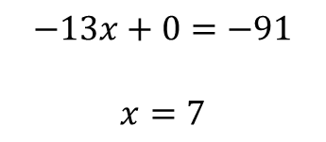
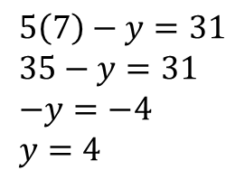

24
7
30
Date
Simultaneous equations
EQ –How can we solve simultaneous equations with the elimination method
1
$$5x−y=31$$
$$2x−3y=2$$
2
1
$$×−3$$
$$−15x+3y=−93$$
$$5\left(7\right)−y=31 \\ 35−y=31 \\ −y=−4 \\ y=4$$
$$2x−3y=2$$
$$−13x+0=−91$$
$$x=7$$
$$x=7 and y=4$$
5
Notes:
Input

Slide 10
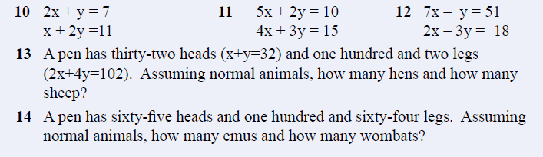
Answer these please
Notes:
Guided practice

Slide 11
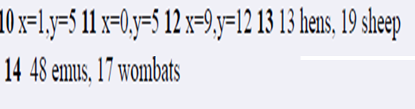
Answers

Slide 12
Summary
Write the steps to solving simultaneous equations with the elimination method.
Which is your favourite method (graphically, substitution or elimination)? Why?
Notes:
Closure

